Slide 1
Coffee SHOP RECOMMENDER SYSTEM
IBM Data Science Capstone
Project

Slide 2
PROBLEM :
“ To develop a recommender system that will help the restaurant manager to find the best suitable place to open an Coffee Shop. “

Slide 3
INTRODUCTION
Toronto is the provincial capital of Ontario and the most populous city in Canada, with estimated population of 2,956,024 and an estimated population of 6,341,935 in the Toronto region.
The city has many restaurants, coffee shops, cafe, hotels. The variety of food items are provided by these shops.
One of the popular item is an Coffee. Thus, there are many Ice Cream Shops in the various areas of the city.
Therefore, if someone decides to open an Coffee Shop in the city,
he would select the best suitable place for the shop.
To get the information about this suitable place, the recommender
system can be used

Slide 4
The questions that should be answered
Which place is the most suitable and popular for the Coffee Shop
?
What type of Coffee should be provided ? What type is preferred
by people in that area ?
What type of people live in that area ( students, company
employees, etc ) ?
How many similar shops are present in that area ?
What other specialities should be provided to attract customers ?
What should be the cost of the Coffee provided ?

Slide 5
TARGET AUDIENCE
Target audience for this system are the managers or people who want to open an Coffee Shop in the specific city or area. These people expect the place which is most popular and well known in the city.

Slide 6
DATA
To open a shop, following things are required –
▫ Geographical coordinates of the area
▫ The population of the neighbourhood
▫ The type of people in the neighbourhood
▫ Average income of the people nearby that area
▫ The preference of people towards the type of food
▫ Other service details such as juice, transport, taxi, etc.
The above information was obtained from the various websites such
as Wikipedia, Foursquare API, census report websites, csv data, etc.

Slide 7
METHODOLOGY
The following steps were followed –
get the data of neighbourhoods in Toronto
use the pandas HTML table scraping method for web scraping
get the longitude and latitude coordinates of the areas from csv file
match the areas and the coordinates
visualize the map of Toronto using the Folium library package
get the list of top nearest venues using Foursquare API
group the venues by their categories
selected the category as “ Coffee Shop”
use the K-Means clustering method to form the clusters of the data.
by analysing the results, the final results were obtained

Slide 8
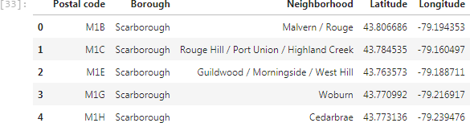
Initial data :
Dataframe after matching venues and
the coordinates :

Slide 9
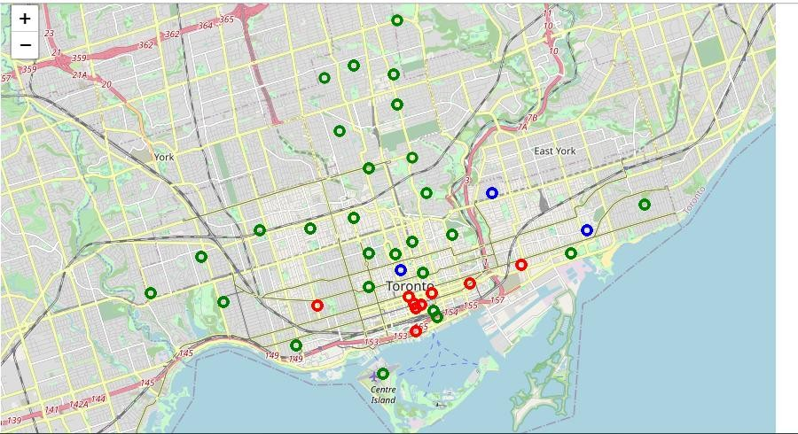
RESULTS
Map showing the clusters :

Slide 10
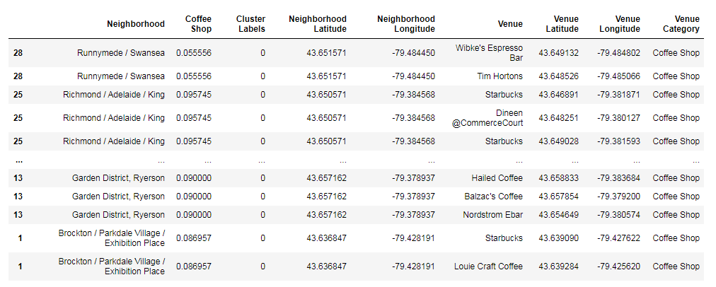
RESULTS
Table – Cluster 0 :

Slide 11
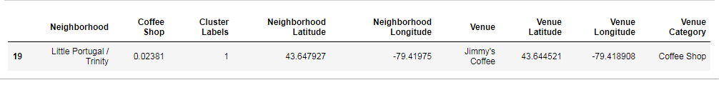
RESULTS
Table – Cluster 1 :

Slide 12
RECOMMENDATION
By analyzing nearby venues, we can conclude that the cluster 1 does not have many Coffee shops in that areas. Thus, it would be suitable to select these locations for opening ice cream shops.
Therefore, locations like Central Bay Street, Riverdale, The Beaches West, Commerce court will be good to open a new Ice Cream Shop.

Slide 13
CONCLUSION
The recommender system correctly recommends the most suitable place to open an Coffee Shop. Thus, it can provide good results to the users of the system.
The system can also be used as recommendation system for opening
the restaurants, coffee shops, street food shop, etc.
Using this method the recommendation system for malls, theatres,
shops can also be designed.

